Slide 1

MRI of Ice Formed by Sea Spray
Grant Wilbur

Slide 2
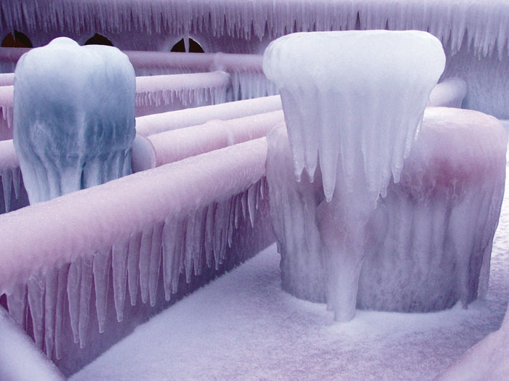
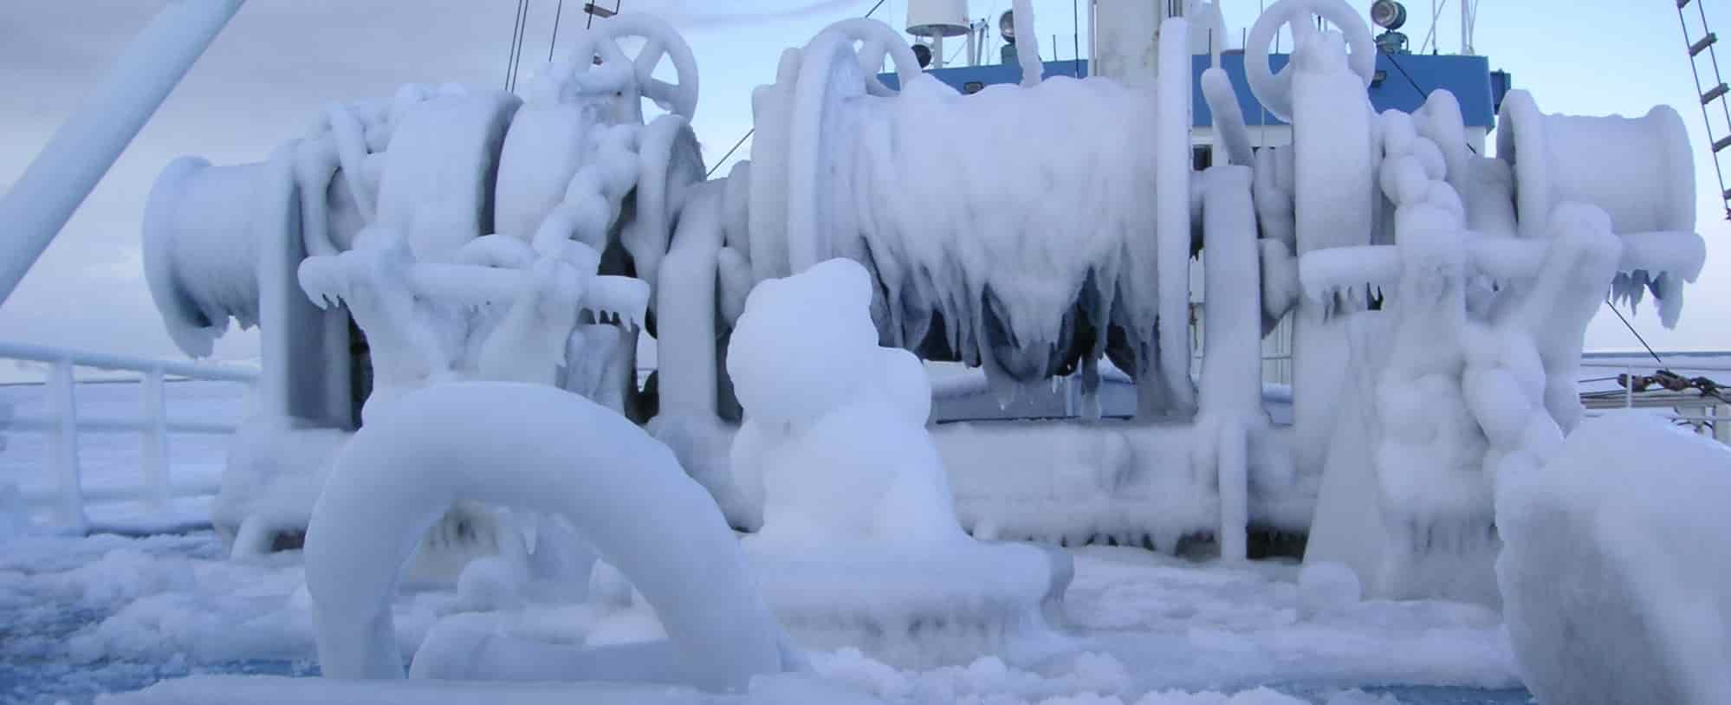
Motivations
Ice buildup on marine vessels can be very dangerous
Work is being done on computational models for thermal and structural properties of these ices
Some NMR measurements have been made on these ices
No one has done MRI on these sea ices
Notes:
We are trying to help the computational physicists with their numerical solutions

Slide 3
Experiment
Creating simulated sea ice within an MRI scanner
Make measurements!
SPRITE images, T₂ , and T₁ – T₂ mapping

Slide 4
How Does MRI/NMR Work
NMR (Nuclear Magnetic Resonance) is the phenomenon which allows us to do MRI
Fairly simple! (if you know some E&M)
MRI is a series of techniques that exploit NMR
Varying complexity depending on the technique

Slide 5
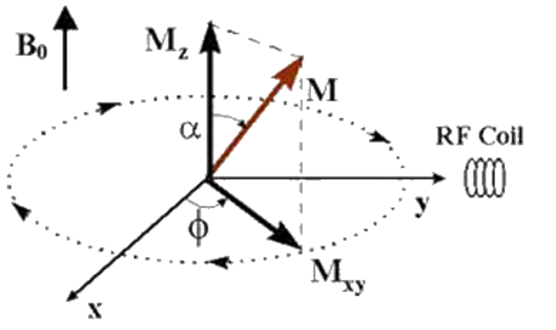

NMR Basics
Sample is placed in external magnetic field causing spins to align in z direction.
RF pulse is applied causing magnetization vector to tip into transverse plane.
Once the RF pulse has ended, the magnetization precesses in the transverse plane as it re-aligns with the external field
Visualization of magnetization vector tipping
into transverse plane after application of
RF pulse.

Slide 7
Specific Challenges
Our apparatus cannot directly detect the spins in ice
T₂ Water ≈ 50 – 160ms
T₂ Ice ≈ 10us
NMR probe dead time: 40us
Notes:
Water T2: 130ms
Ice T2: ~10us

Slide 8
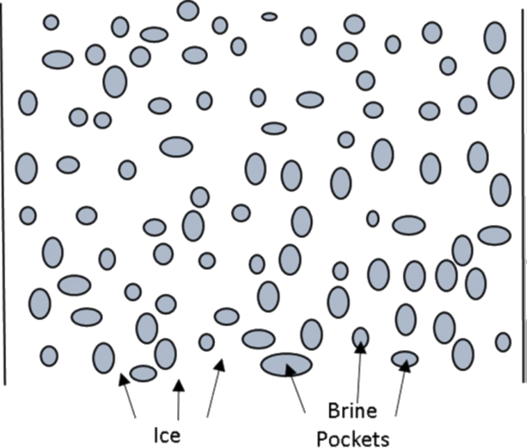
Structure of Brine-Spongey Ices
Ice created by sprays of salt water are different that ice created by pure water

Slide 9
Experimental Setup
-10⁰C sea water spray
-30⁰C Liquid Nitrogen vapour
Water Nozzle
Sea Ice buildup
5mm Glass tube

Slide 10
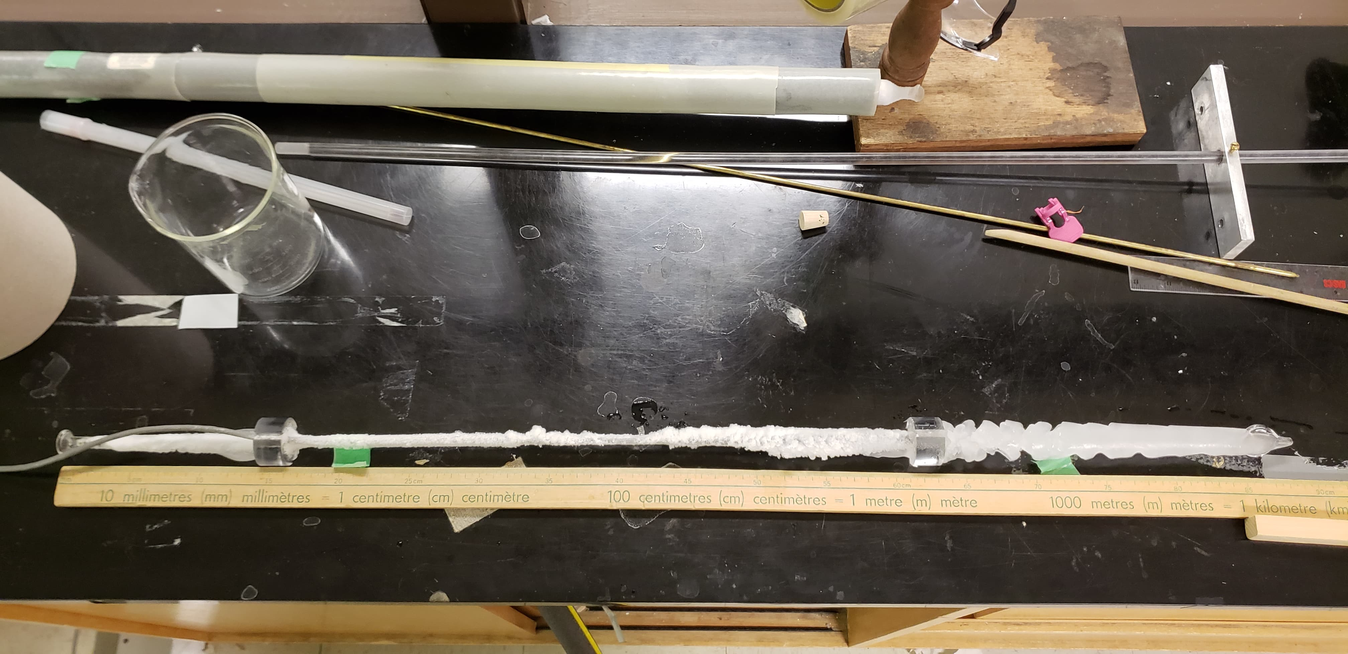
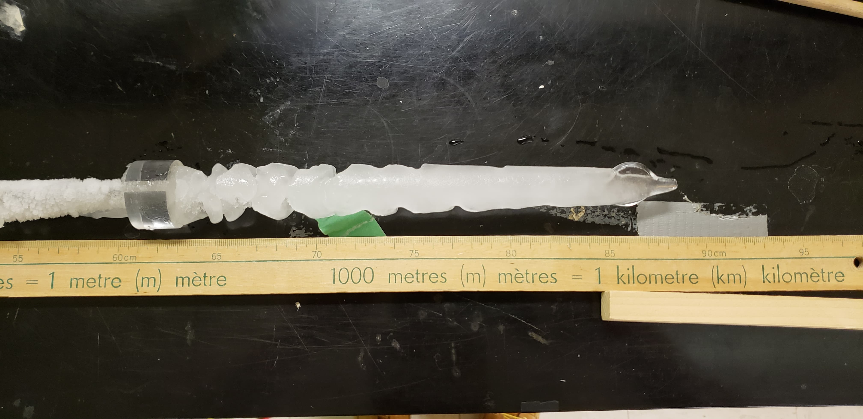
What Does the Ice Look Like?

Slide 11
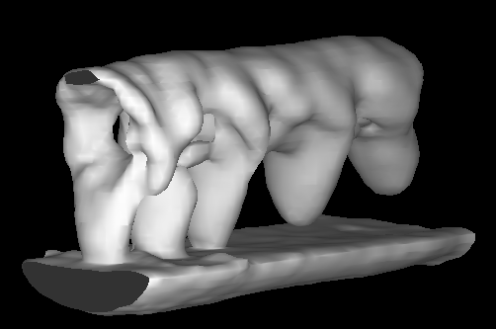
MRI Results
We can determine several things from the MRI data:
Ice growth as a function of time
Patterns in the ice structure
Take roughly 2.5 minutes per image

Slide 12




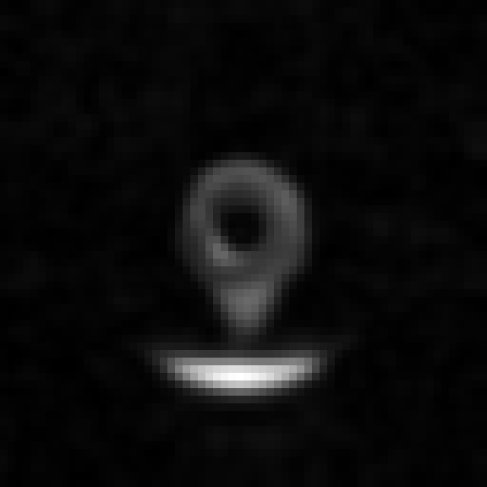




Notes:
8 clicks
Each image take roughly 4 minutes apart
Each image takes ~2:30

Slide 13











Notes:
10 clicks

Slide 14
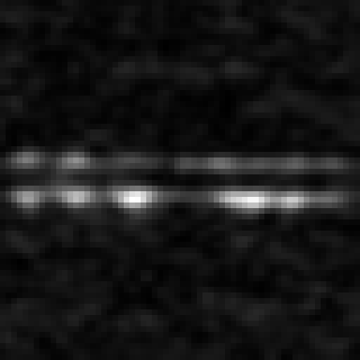
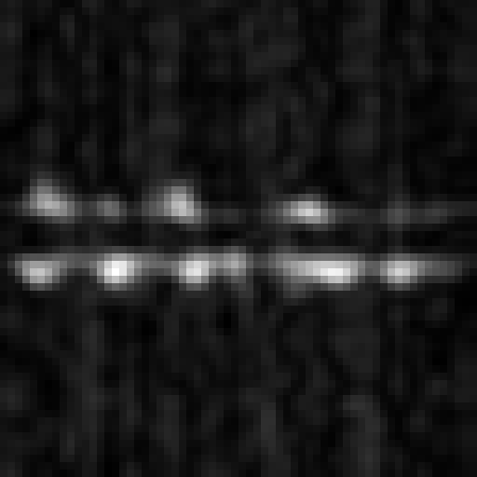
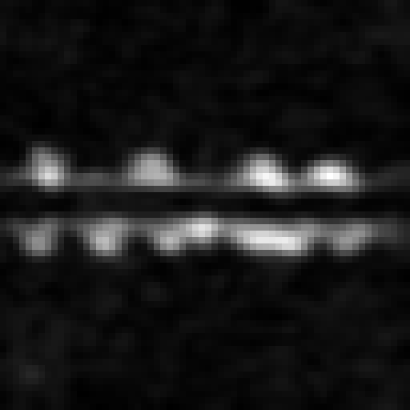

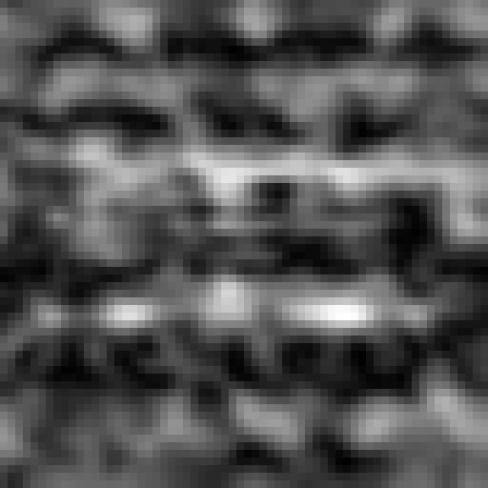



Notes:
7 clicks

Slide 15
Experimental Results: T₁-T₂ Map
Bulk measurement
No spatial information
Plots of T₁ vs T₂ reveal information about the environments the spins are in

Slide 16
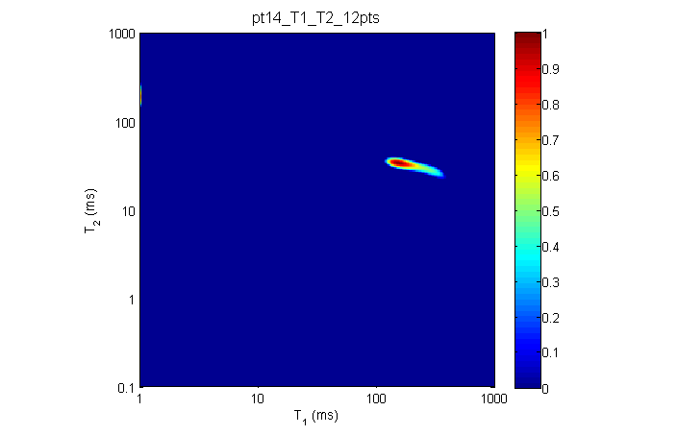
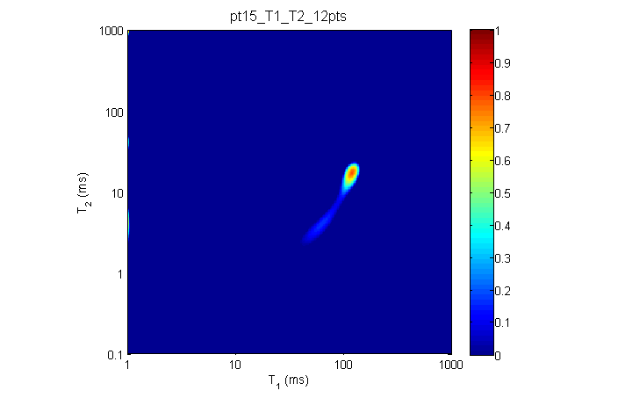
T₁ = 158ms
T₂ = 34ms
T₁ = 60ms
T₂ = 3.6ms
T₁ = 125ms
T₂ = 27ms
Notes:
Pt 14: T1 = 158ms, T2 = 34ms
Pt 15: T1 = 125ms, T2 = 27ms
Secondary: T1 = 60ms, T2 = 3.6ms
Shorter Relaxation times imply more active energy exchange

Slide 17
Conclusion
We have obtained spatially resolved structural information about sea ices formed from sea spray
We have made some bulk measurements of these ices which can could be made in-situ

Slide 18

Acknowledgements
Igor Mastikhin – Supervisor
Florin Marica – Research Scientist
Brian Titus – Machinist
Brian Malcolm – Glassblower

